Slide 1
Non life Insurance Highlights
General Insurance Council

Slide 2
Non Life Insurance Penetration & Density
Source: IRDAI

Slide 3
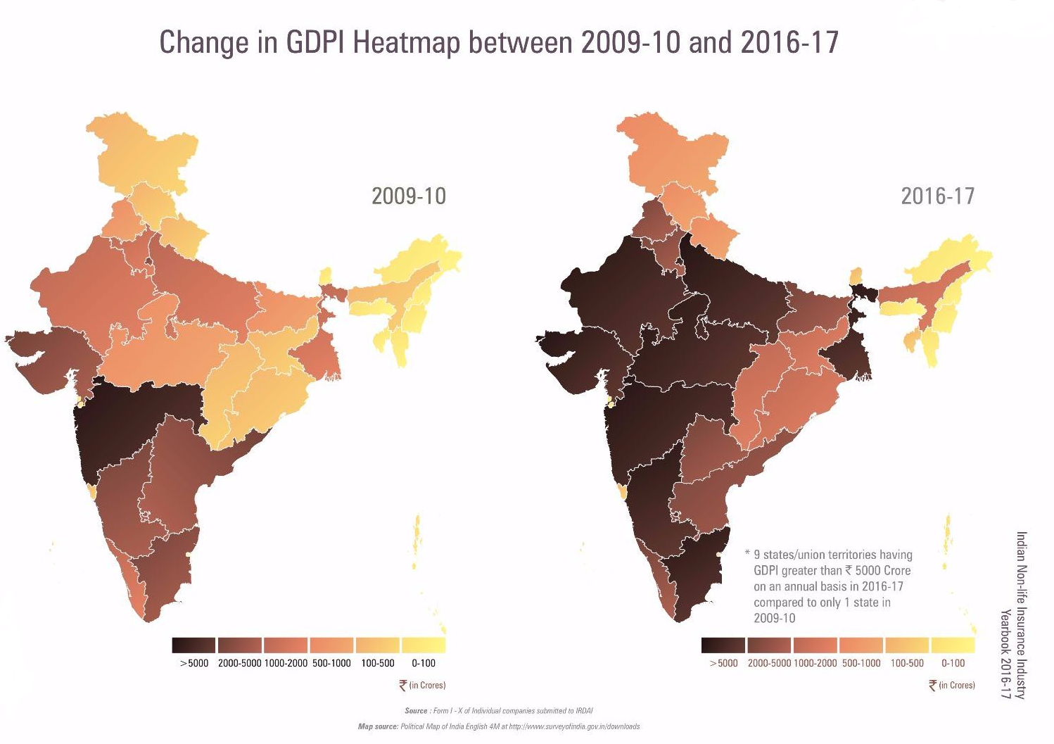
General Insurance Council

Slide 4
Source: Council Collation
General Insurance Council

Slide 5
Source: Council collation
General Insurance Council

Slide 6
Source: Council Collation
General Insurance Council

Slide 7
Market Share of Companies For FY 2017 in terms of GDP
Source: Council Collation

Slide 9
Source: Public Disclosures
General Insurance Council

Slide 10
Source: Public Disclosures

Slide 12
Motor & Health Growth % (63.5% overall Market Share)
Source: Council collation

Slide 13
Source: Council Collation
General Insurance Council

